Slide 1
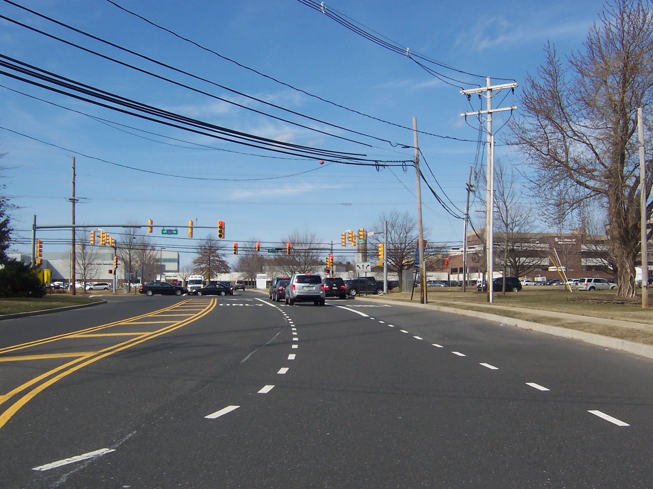
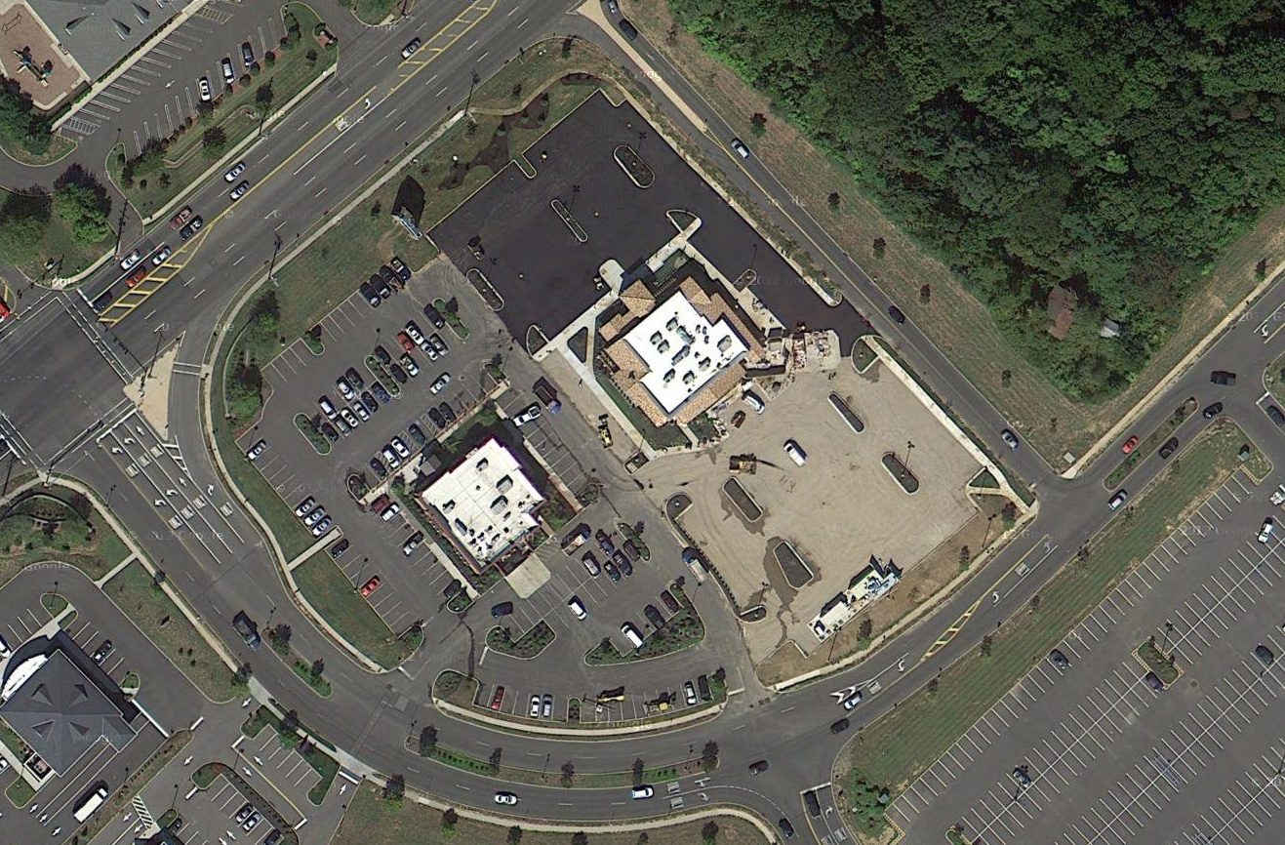
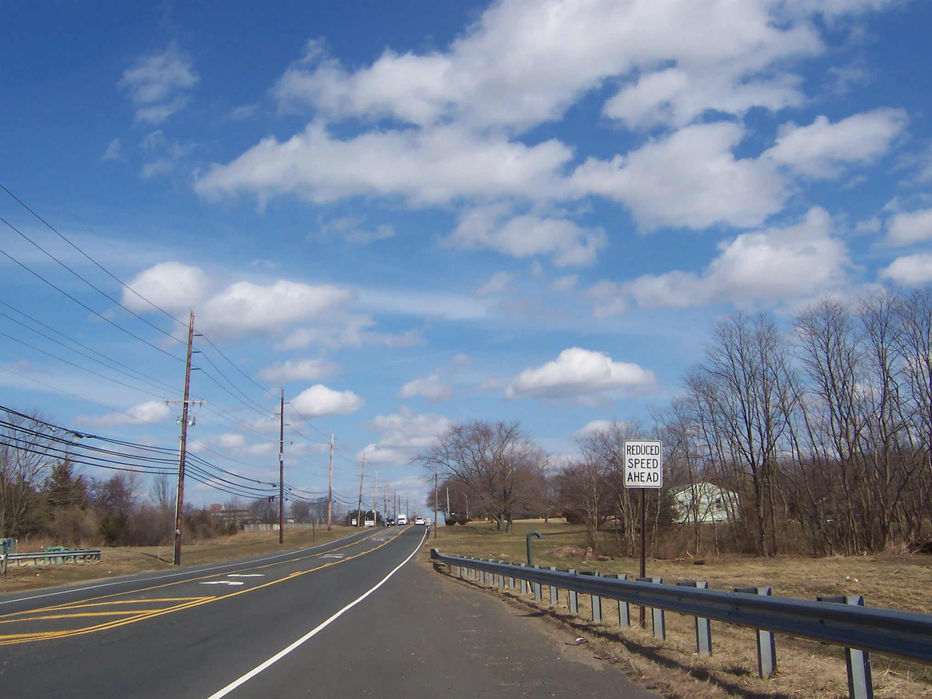

Route 537 Corridor Improvements
Township of Upper Freehold | Monmouth County, NJ
Van Cleef provided subconsultant services for the Concept Development and Preliminary Design phases of operational and safety improvements for a 1.8-mile section of Monmouth County Route 537. The corridor has several substandard design elements, traffic congestion issues, and traffic movement capacity issues for which conceptual solutions will be developed to improve safety and reduce congestion while still taking into account practical measures to avoid, minimize, or mitigate potential impacts to the built and natural environment.
Existing deficiencies to be evaluated and corrected include lack of shoulders along the entire length; substandard auxiliary lane widths along exterior lanes; substandard vertical stopping sight distance at two locations; few auxiliary lanes, deceleration lanes or shoulders for turning movements at intersections as well as into various business/shopping complexes; and substandard lane drops along the westbound approach to the Route 33 Freeway. Additionally, much of the corridor is not bicycle or pedestrian compatible. There are also numerous substandard design elements at the CR 537 Interchanged with US Route 9, which is included within the project study limits.
As a subconsultant, Van Cleef’s role on this project included providing surveying and basemapping, evaluation of roadway and safety deficiencies of the transportation network and utility coordination. Van Cleef also developed the alternative analysis matrix, which evaluated the benefits and impacts of various improvement concepts, including level of service, right-of-way, environmental permitting, utility relocations, constructability, community support and construction costs. Our efforts required a significant Public Outreach effort with local property owners, residents, businesses, schools, the hospital and public officials.
Monmouth County
Engineering Department
Freehold, NJ
NJTPA Oversight
Concept Plan Design
Complete Streets Design
ADA Curb Ramp Assessments
Signalized Intersections
Utility Coordination
Stormwater Management
ROW Assessments
Environmental Screening
Public Outreach

