Slide 1
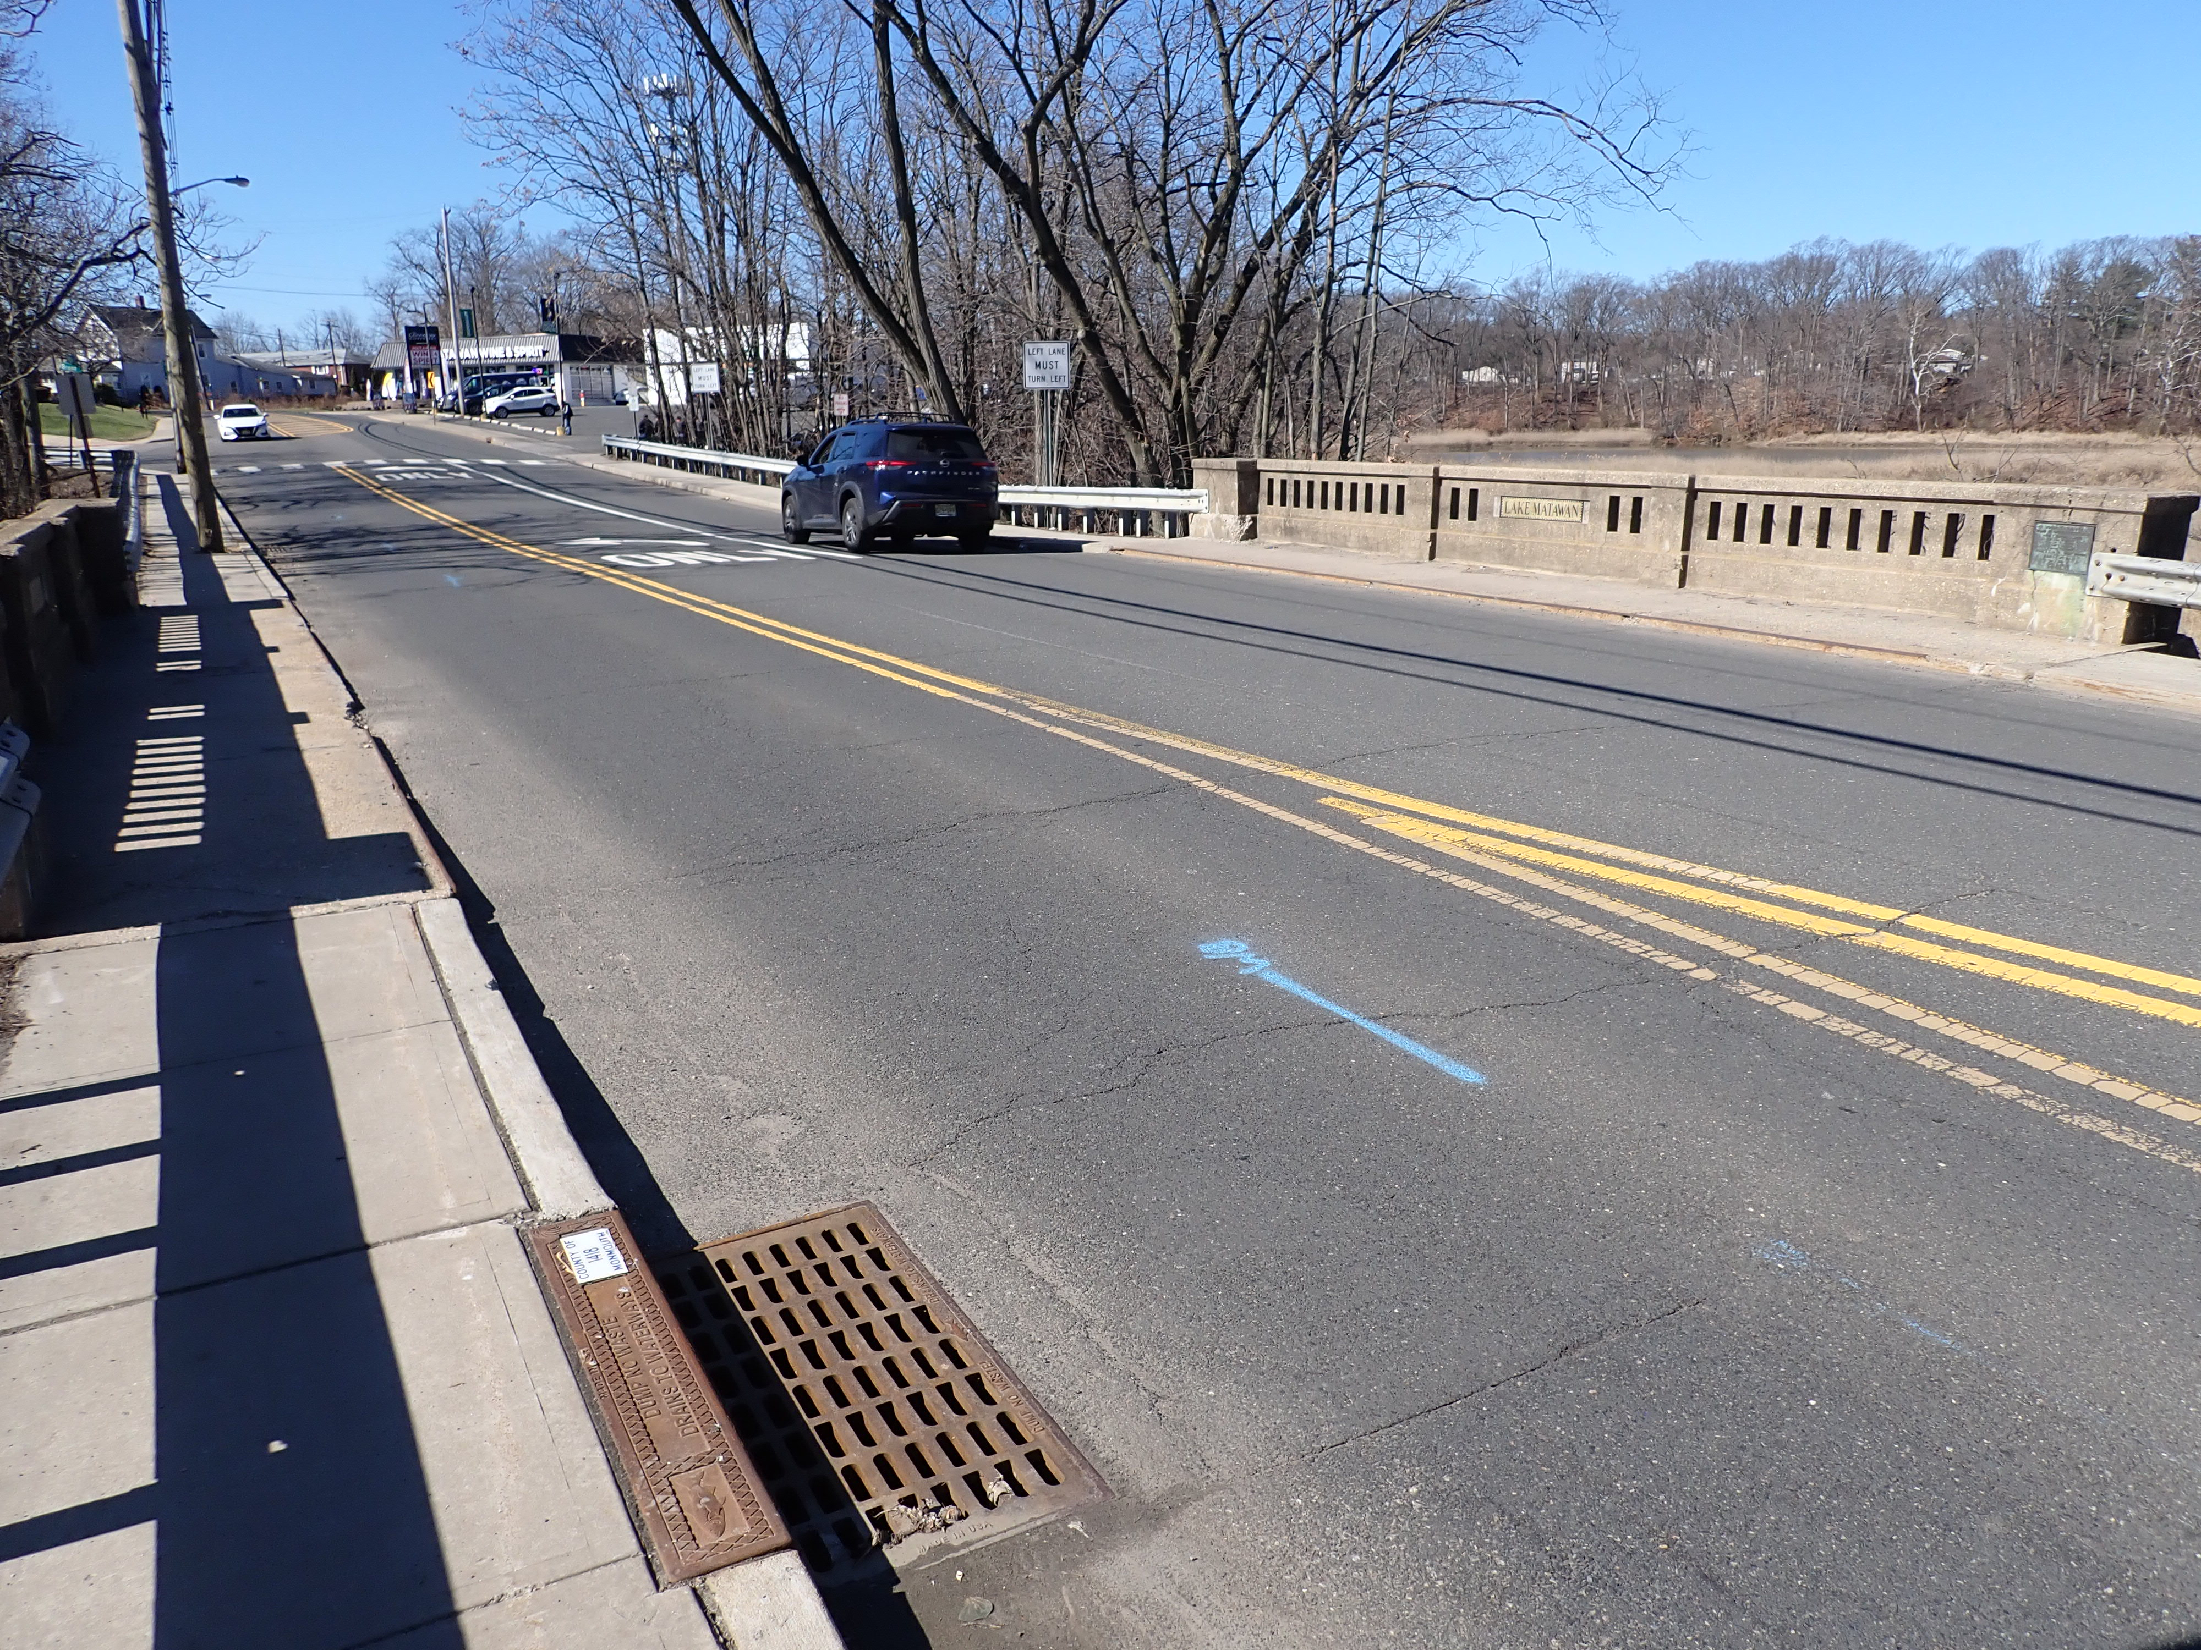
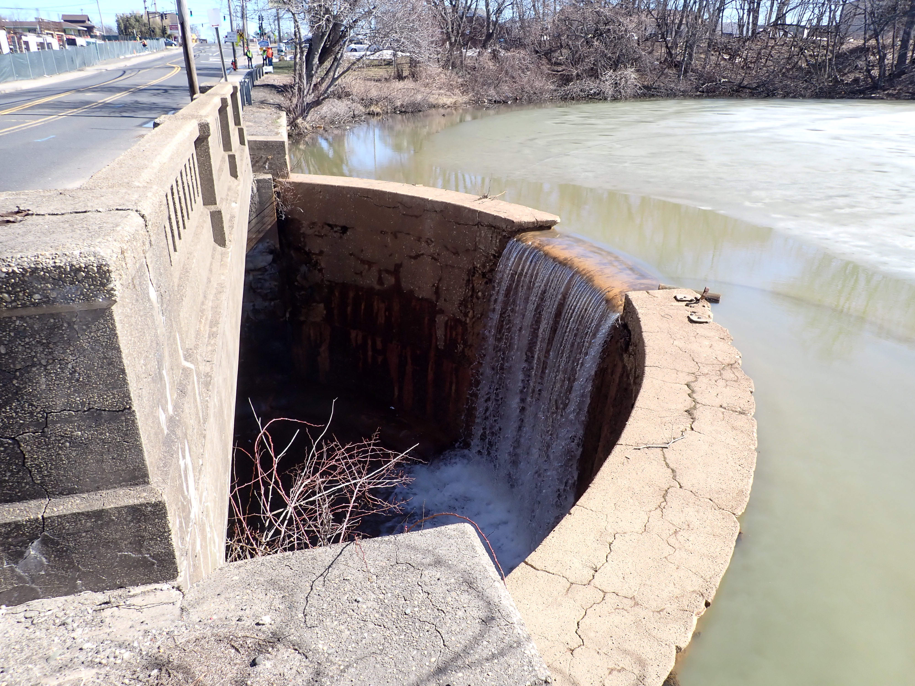
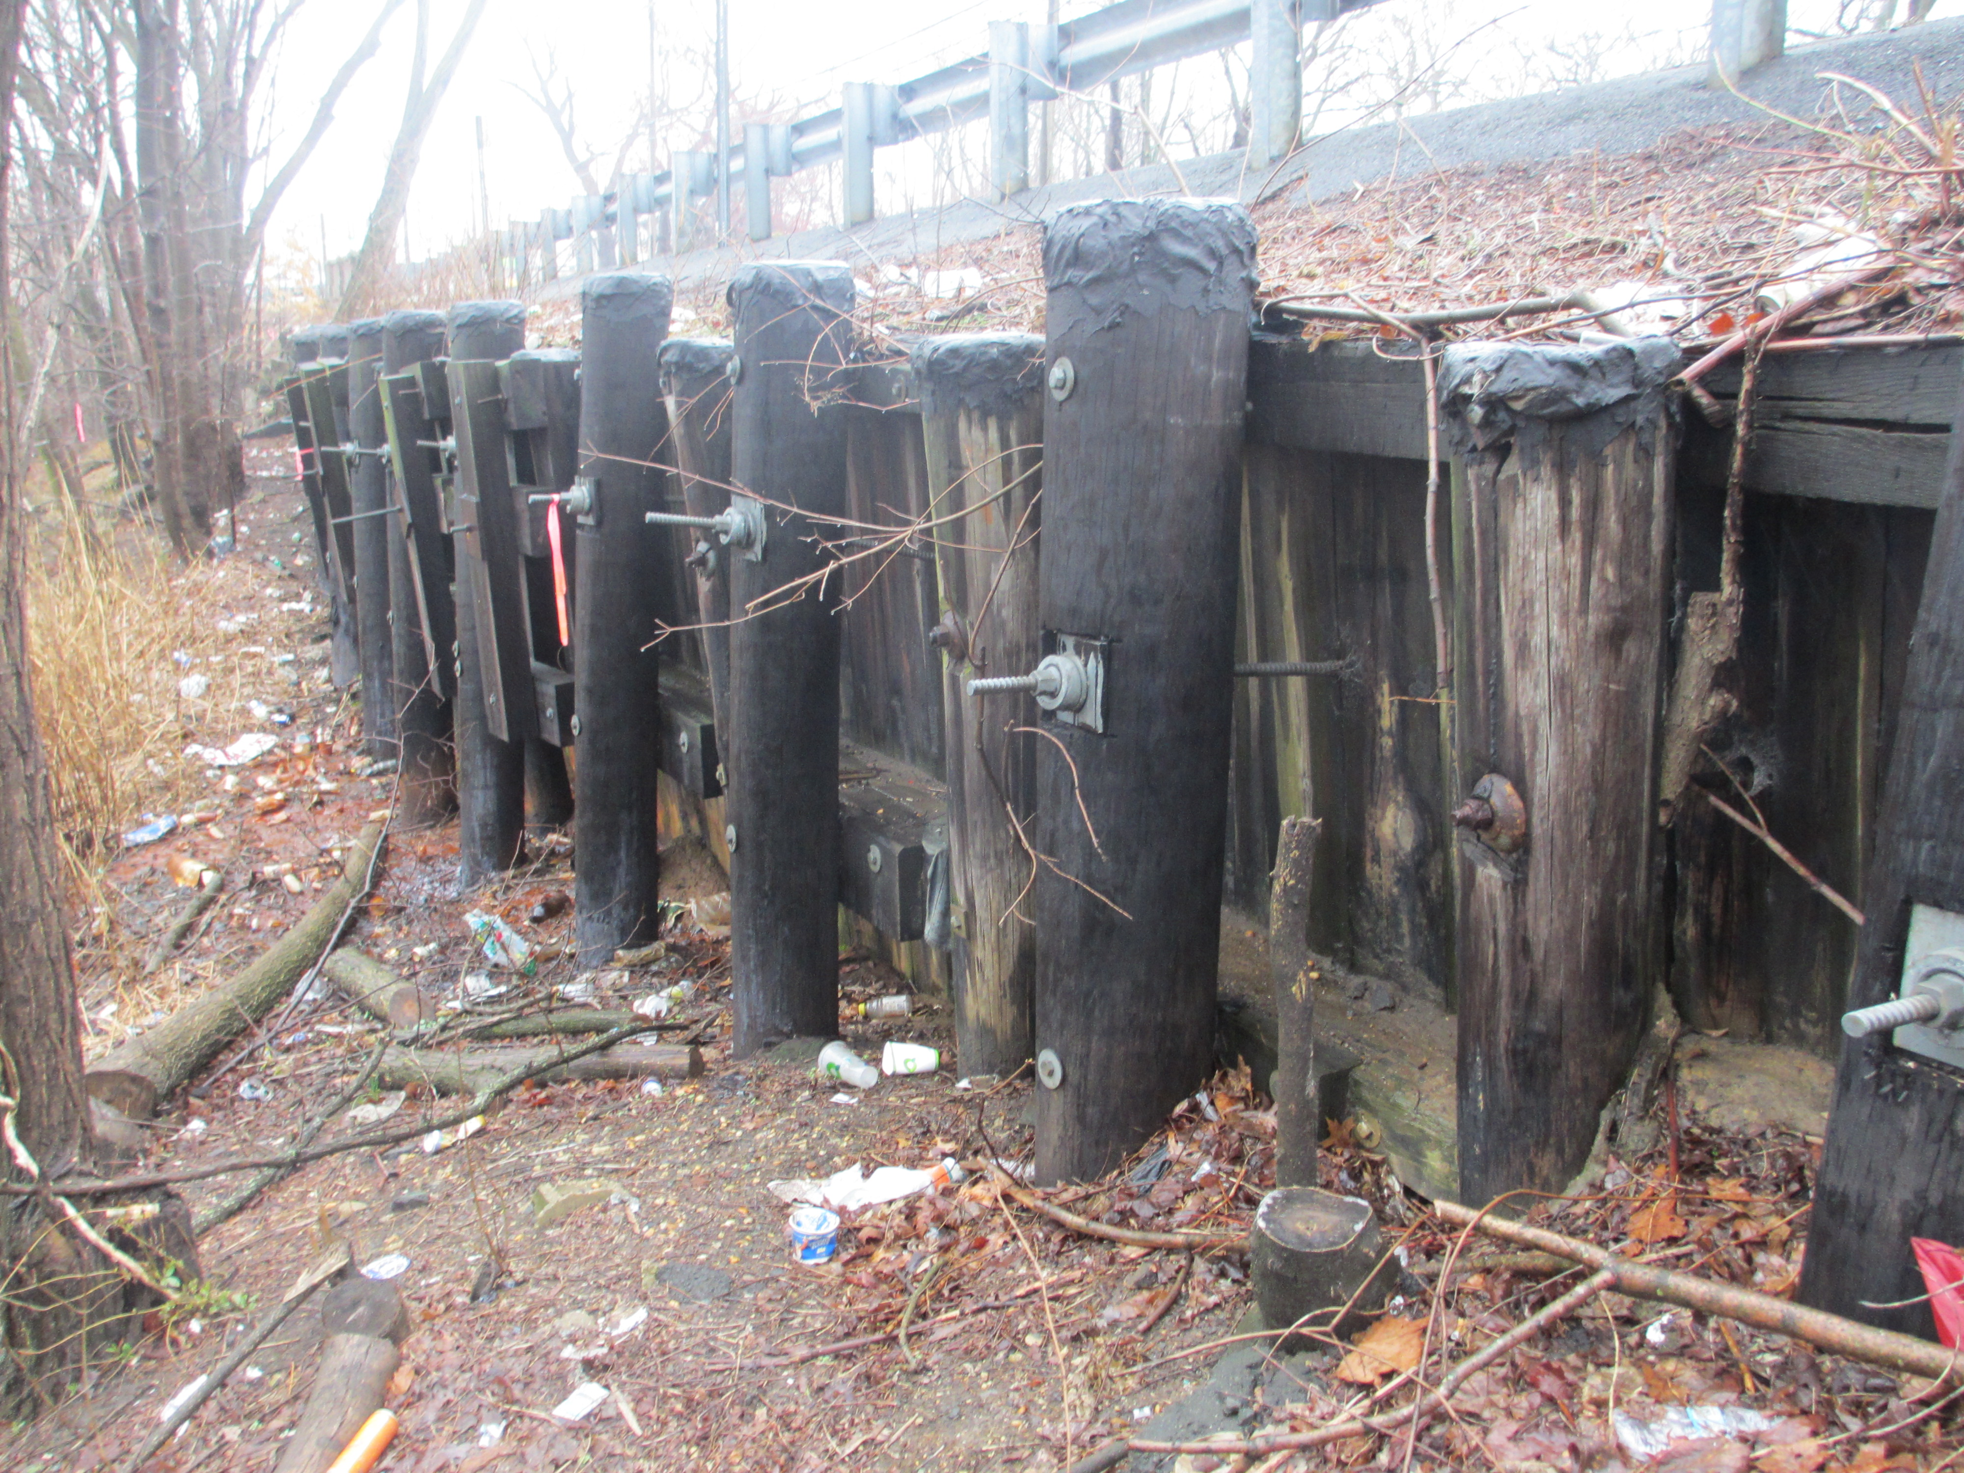

Replacement of Bridge MA-13 on County Route 516
(Main Street) over Lake Matawan
Borough of Matawan | Monmouth County, NJ
Van Cleef was contracted by the County of Monmouth to provide design services for the design of the Reconstruction of Bridge MA-13 on CR 516 over Matawan Creek. Bridge MA-13 is a 43 foot long, single span, concrete-encased, steel girder bridge reconstructed in 1925, partially on existing masonry abutments. At that time, portions of the then existing abutments were incorporated into the reconstruction of the present bridge. The foundation configuration of the pre-existing abutments which were re-used is unknown, but the abutments and wingwalls constructed in 1925 at the downstream, northerly, side of Bridge MA-13 are concrete gravity type walls with minimal reinforcement and are founded on timber piles. The current abutments are protected from scour by a concrete apron that extends from the spillway for the Lake Matawan Dam. Bridge MA-13 carries three (3) lanes of traffic (one eastbound, two westbound including the left turning lane for Broad Street) with a cartway width of 33’ from curb-to-curb. The total out-to-out of structure is 46’-6”, including two (2) sidewalks. The existing structure supports several utilities beneath the structure and a sanitary force main along the north fascia.
The new structure was designed as a single span steel beam structure consisting of a 12’ wide lanes, 8’ wide shoulders, and 6’ wide sidewalks. The profile will be increased by over 2’ to accommodate spillway flows under the bridge. The project required complex staging and significant utility relocations. The project was designed in accordance with Monmouth County, NJDOT, and AASHTO design standards. Community Outreach was required, including coordination with local residents, businesses, and local officials.
Monmouth County
Engineering Department
Freehold, NJ
Bridge Replacement
Utility Coordination & Relocation
Dam Spillway Design
Hydraulics & Hydrology Design
Roadway & Geotechnical Design
Staged Construction & Detours
Environmental Permitting
Public Outreach
Cultural Resources

